Slide 1
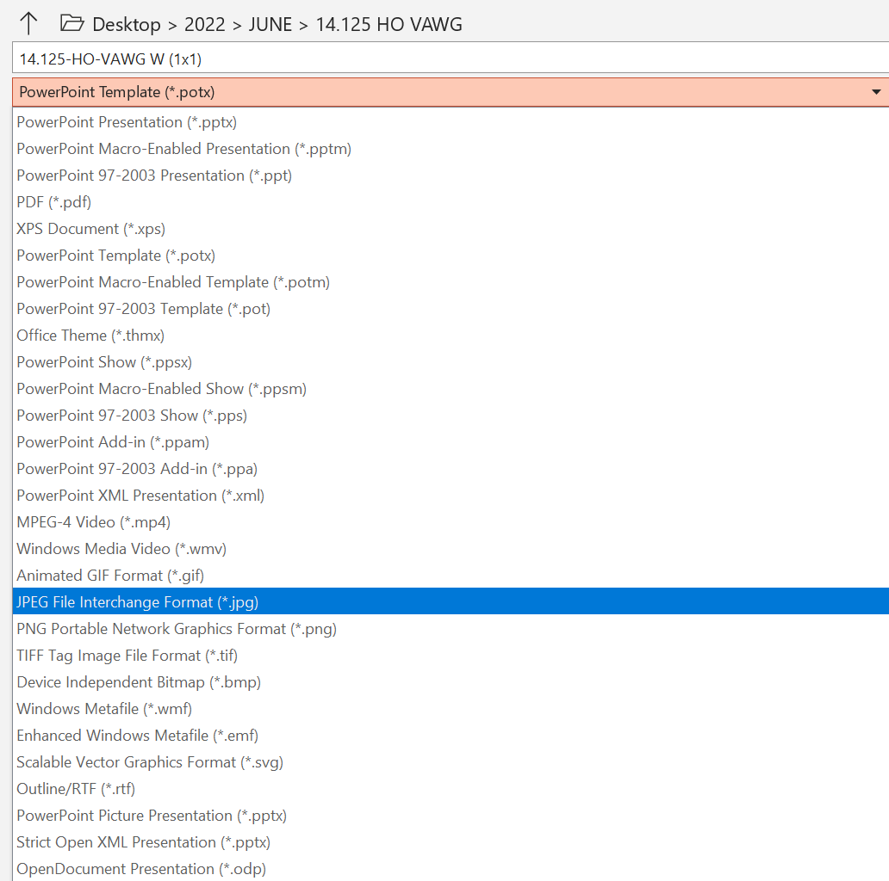
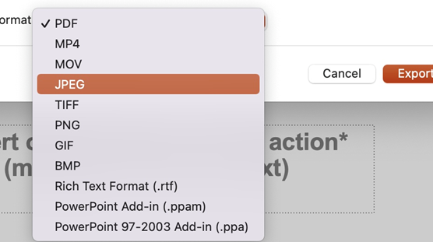
HOW TO SAVE AS AN IMAGE
On PC:
Click ‘File’ then ‘Save as’
Next to ‘Save as type’, click the dropdown menu and select ‘JPEG File Interchange Format (*.jpg)’
Click ‘Save as’ (see below)
On Mac:
Click ‘File’ then ‘Export’
Choose JPEG in the ‘File Format’ dropdown menu
Click ‘Export’ (see below)
All partner assets must be approved by the Enough campaign team before use. Please contact the team on enough@homeoffice.gov.uk

